Slide 1

Rational Agents (Chapter 2)

Slide 2
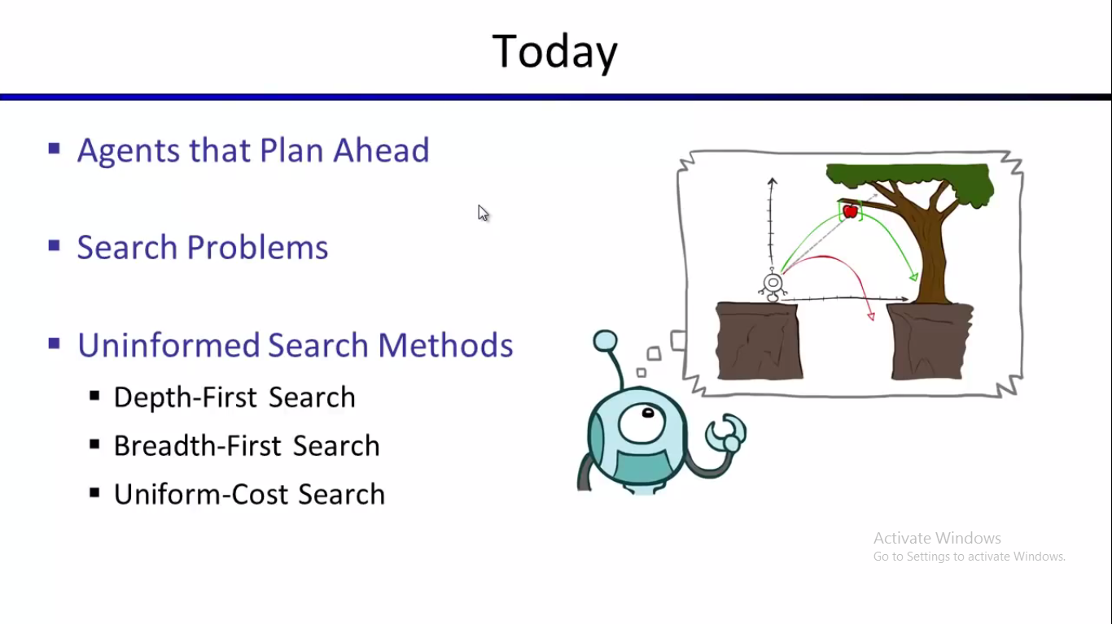



Slide 3
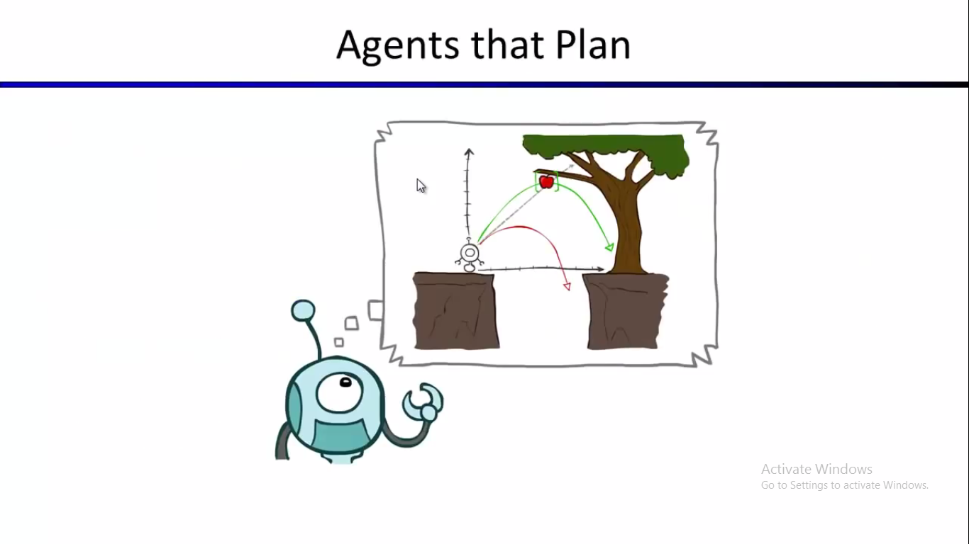

Slide 4
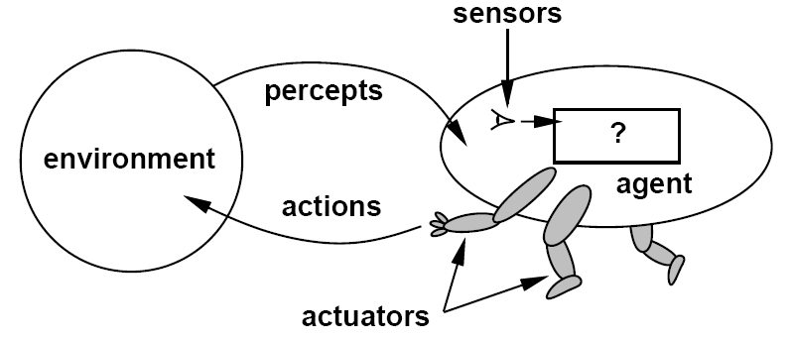
Agents
An agent is anything that can be viewed as perceiving its environment through sensors and acting upon that environment through actuators

Slide 5
Agents
What will be the component of Human Agent?
Human agent:
Sensors: eyes, ears, and other organs for sensors;
Actuators: hands, legs, mouth, and other body parts.
What will be the component of Robotic Agent?
Robotic agent:
Sensors: cameras, touch sensor and infrared range finders
Actuator: various motors for actuators

Slide 6
Agents and environments
The agent function maps from percept histories to actions:
[f: P*→ A]
The agent program runs on the physical architecture to produce f.
agent comprised of : architecture + program

Slide 7
Agents & Environments
The agent takes sensory input from its environment, and produces as output actions that affect it.
Agent
sensor
input
action
output
Environment

Slide 8

Vacuum-cleaner world
Percepts: location and contents, e.g., [A,Dirty]
Actions: Left, Right, Clean, NoOp

Slide 9
Example: Vacuum-Agent
Percepts: Location and status, e.g., [A,Dirty]
Actions: Left, Right, Suck, NoOp
function Vacuum-Agent([location,status]) returns an action
if status = Dirty then return Suck
else if location = A then return Right
else if location = B then return Left

Slide 10
A vacuum-cleaner agent
Percept Sequence | Action
[A, Fresh] | Right
[A,Dirty] | Clean
[B, Fresh] | Left
[B, Dirty] | Clean
[A, Fresh], [A, Fresh] | Right
[A, Fresh], [A,Dirty] | Clean
…. | …..
[A, Fresh], [A, Fresh], [A, Fresh] | Right
[A, Fresh], [A, Fresh], [A, Dirty] | Clean
….. | ….

Slide 11
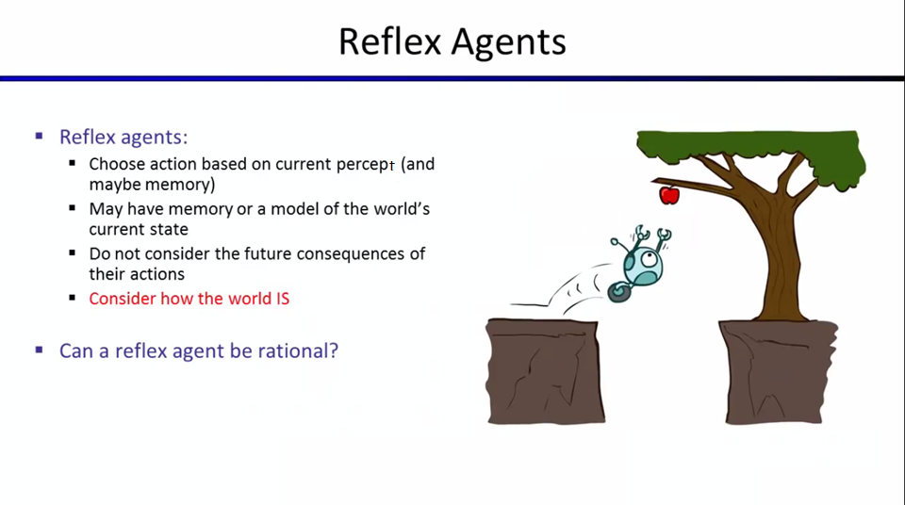

Slide 12
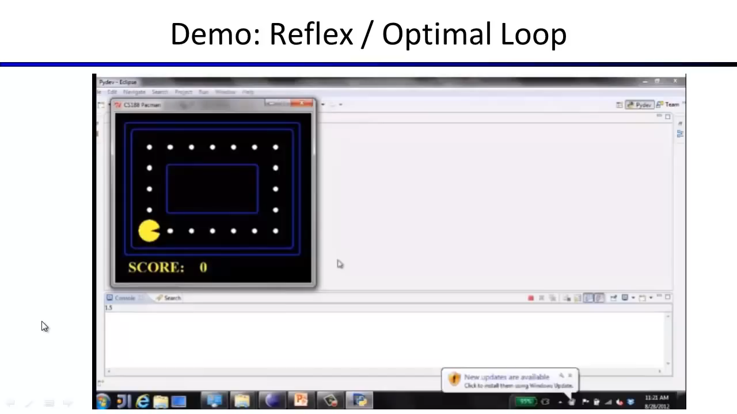



Slide 13
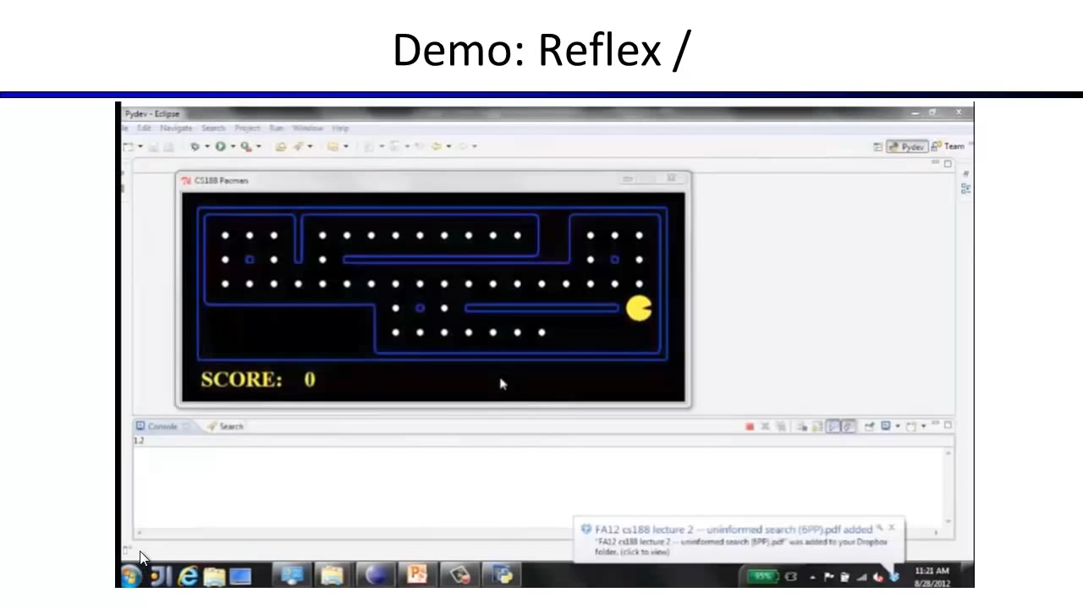

Slide 14
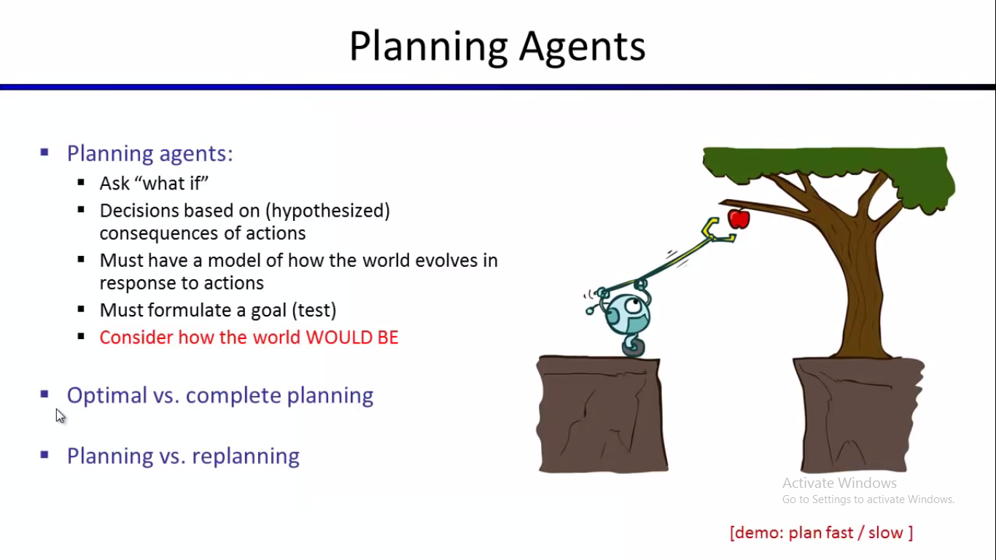

Slide 15
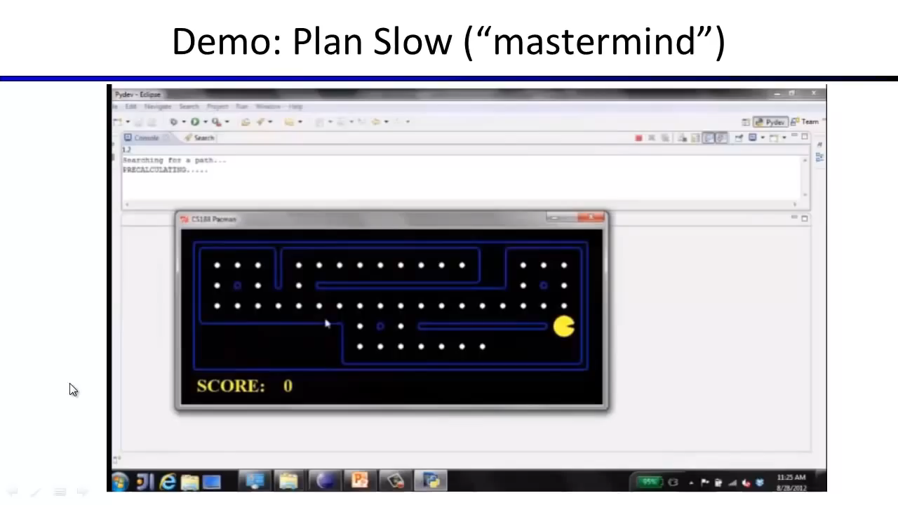

Slide 16
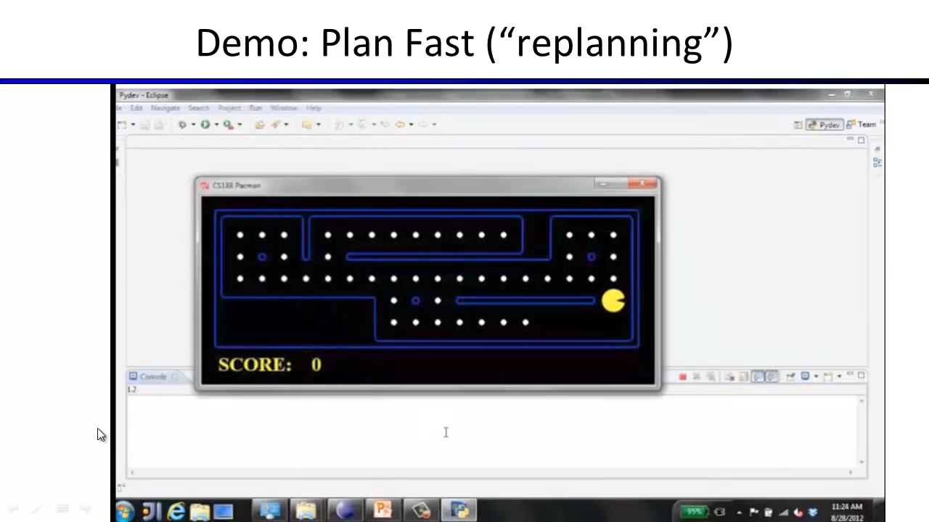

Slide 17
Rational agents (1/3)
An agent should strive to "do the right thing", based on what it can perceive and the actions it can perform. The right action is the one that will cause the agent to be most successful.
Performance measure: An objective criterion for success of an agent's behavior.
E.g., performance measure of a vacuum-cleaner agent could be amount of dirt cleaned up, amount of time taken, amount of electricity consumed, amount of noise generated, etc.

Slide 18
Rational agents (2/3)
Rational Agent: For each possible percept sequence,
a rational agent should select an action that is expected to maximize its performance measure,
given the evidence provided by the percept sequence and whatever built-in knowledge the agent has.

Slide 19
Rational agents (3/3)
An agent is autonomous if its behavior is determined by its own experience
(with ability to learn and adapt).

Slide 20
Back to Vacuum-Agent
Percepts: Location and status, e.g., [A,Dirty]
Actions: Left, Right, Suck, NoOp
function Vacuum-Agent([location,status]) returns an action
if status = Dirty then return Suck
else if location = A then return Right
else if location = B then return Left
Is this agent rational?
Depends on performance measure, environment properties

Slide 21
Agent Characterisation
An agent is responsible for satisfying specific goals. There can be different types of goals such as achieving a specific status (defined either exactly or approximately), keeping certain status, optimizing a given function (e.g., utility), etc.
The state of an agent includes state of its internal environment + state of knowledge and beliefs about its external environment.
knowledge
beliefs
Goal1
Goal2

Slide 22
Goal I (achieving exactly defined status)
Initial State
Goal

Slide 23
Goal II (achieving constrained status)
Goal
Constraint:
“The smallest in on top”
Initial State
OR

Slide 24
Goal III (continuously keeping instable status)
Initial State
Goal

Slide 25



Goal IV (maximizing utility)
Goal:
The basket filled with mushrooms that can be sold for maximum possible price
Initial State

Slide 26
Situatedness
An agent is situated in an environment, that consists of the objects and other agents it is possible to interact with.
An agent has an identity that distinguishes it from the other agents of its environment.
environment
James Bond

Slide 27
Specifying the task environment
PEAS: Performance measure, Environment, Actuators, Sensors
P: a function the agent is maximizing (or minimizing)
Assumed given
E: a formal representation for world states
For concreteness, a tuple (var₁=val₁, var₂=val₂, … ,var_{n}=val_{n})
A: actions that change the state according to a transition model
Given a state and action, what is the successor state (or distribution over successor states)?
S: observations that allow the agent to infer the world state
Often come in very different form than the state itself
E.g., in tracking, observations may be pixels and state variables 3D coordinates

Slide 28
PEAS Example: Autonomous taxi
Performance measure
Safe, fast, legal, comfortable trip, maximize profits
Environment
Roads, other traffic, pedestrians, customers
Actuators
Steering wheel, accelerator, brake, signal, horn
Sensors
Cameras, LIDAR, speedometer, GPS, odometer, engine sensors, keyboard

Slide 29
Another PEAS example: Spam filter
Performance measure
Minimizing false positives, false negatives
Environment
A user’s email account, email server
Actuators
Mark as spam, delete, etc.
Sensors
Incoming messages, other information about user’s account

Slide 30
Another PEAS example
Agent: Medical diagnosis system
Performance measure: Healthy patient, minimize costs, fewer lawsuits.
Environment: Patient, hospital, staff.
Actuators: Screen display (questions, tests, diagnoses, treatments, referrals).
Sensors: Keyboard (entry of symptoms, findings, patient's answers).

Slide 31
Another PEAS example
Agent: Part-picking robot
Performance measure: Percentage of parts in correct bins
Environment: Conveyor belt with parts, bins
Actuators: Jointed arm and hand
Sensors: Camera, joint angle sensors

Slide 32
Another PEAS example
Agent: Interactive English tutor
Performance measure: Maximize student's score on test
Environment: Set of students
Actuators: Screen display (exercises, suggestions, corrections)
Sensors: Keyboard

Slide 33
Environment types
Fully observable (vs. partially observable): An agent's sensors give it access to the complete state of the environment at each point in time.
Deterministic (vs. stochastic): The next state of the environment is completely determined by the current state and the action executed by the agent
Episodic (vs. sequential): The agent's experience is divided into atomic "episodes" (each episode consists of the agent perceiving and then performing a single action), and the choice of action in each episode depends only on the episode itself.

Slide 34
Environment types
Static (vs. dynamic): The environment is unchanged while an agent is deliberating. (The environment is semidynamic if the environment itself does not change with the passage of time but the agent's performance score does).
Discrete (vs. continuous): A limited number of distinct, clearly defined percepts and actions.
Single agent (vs. multiagent): An agent operating by itself in an environment.

Slide 35
Environment types
Fully observable vs. partially observable
Deterministic vs. stochastic
Episodic vs. sequential
Static vs. dynamic
Discrete vs. continuous
Single agent vs. multi-agent
Known vs. unknown

Slide 36
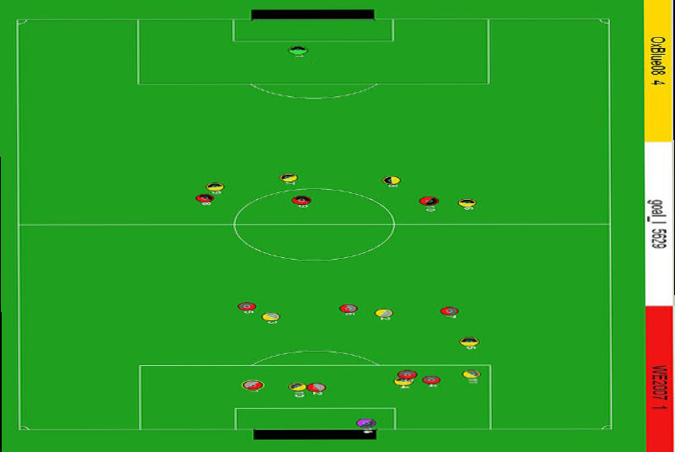
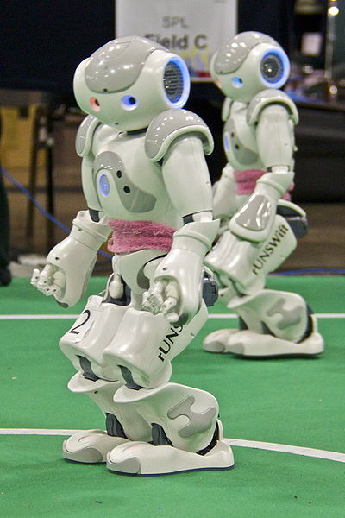
Fully observable vs. partially observable
Do the agent's sensors give it access to the complete state of the environment?
For any given world state, are the values of all the variables known to the agent?
vs.
Source: L. Zettlemoyer

Slide 37
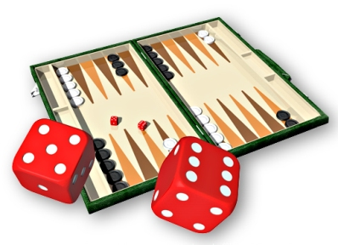
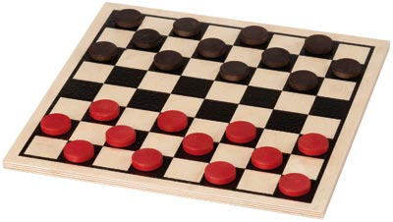
Deterministic vs. stochastic
Is the next state of the environment completely determined by the current state and the agent’s action?
Is the transition model deterministic (unique successor state given current state and action) or stochastic (distribution over successor states given current state and action)?
Strategic: the environment is deterministic except for the actions of other agents
vs.

Slide 38
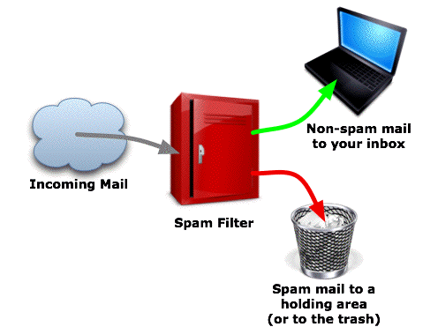
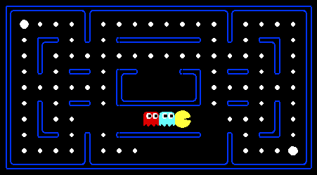
Episodic vs. sequential
Is the agent’s experience divided into unconnected episodes, or is it a coherent sequence of observations and actions?
Does each problem instance involve just one action or a series of actions that change the world state according to the transition model?
vs.
Notes:
Episodic: The agent's experience is divided into atomic “episodes,” and the choice of action in each episode depends only on the episode itself

Slide 39
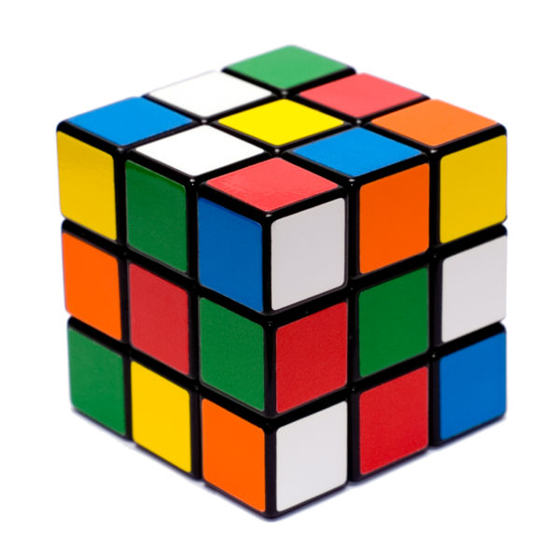
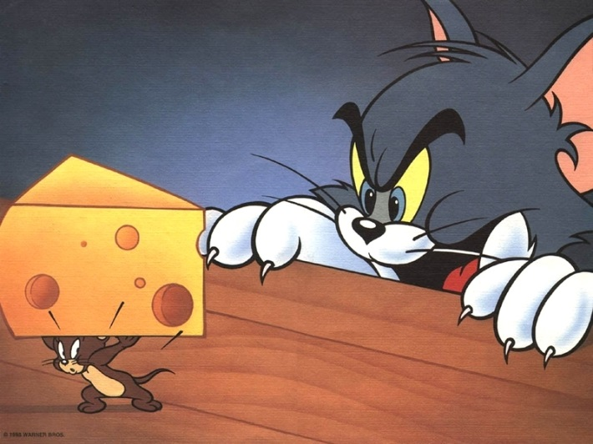
Static vs. dynamic
Is the world changing while the agent is thinking?
Semidynamic: the environment does not change with the passage of time, but the agent's performance score does
vs.

Slide 40
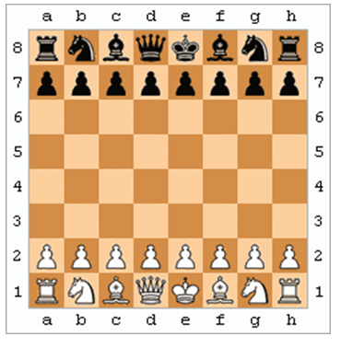
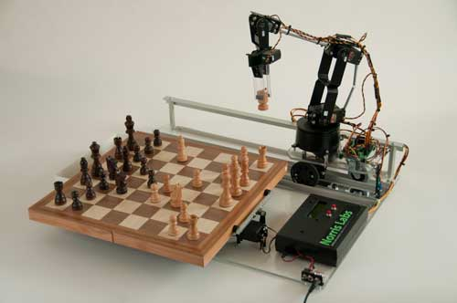
Discrete vs. continuous
Does the environment provide a fixed number of distinct percepts, actions, and environment states?
Are the values of the state variables discrete or continuous?
Time can also evolve in a discrete or continuous fashion
vs.

Slide 41
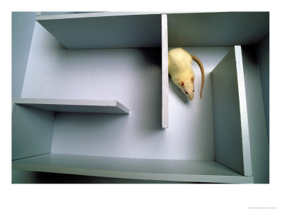
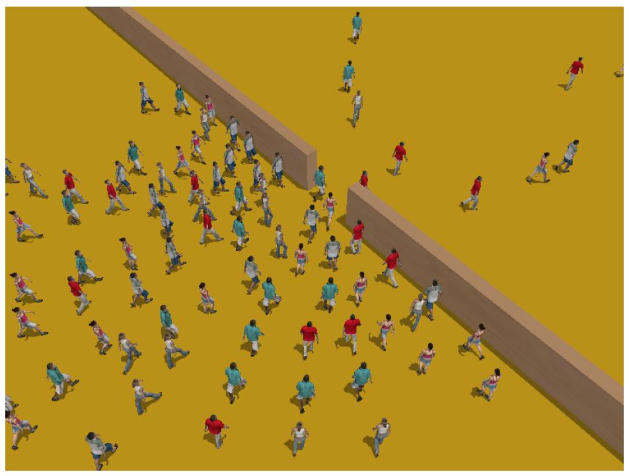
Single-agent vs. multiagent
Is an agent operating by itself in the environment?
vs.

Slide 42
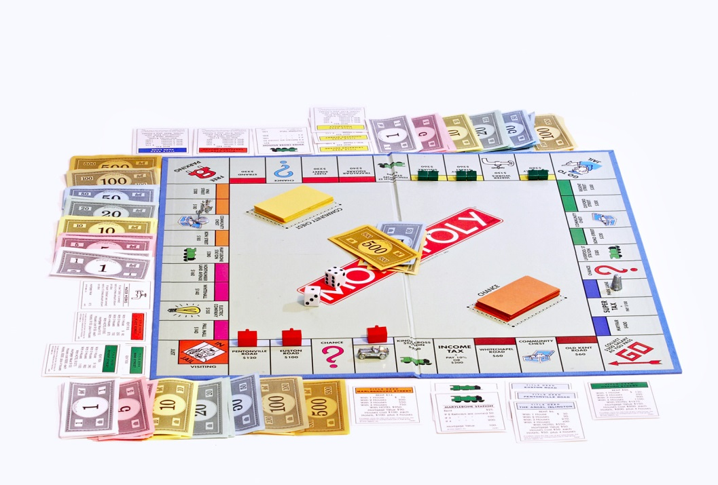
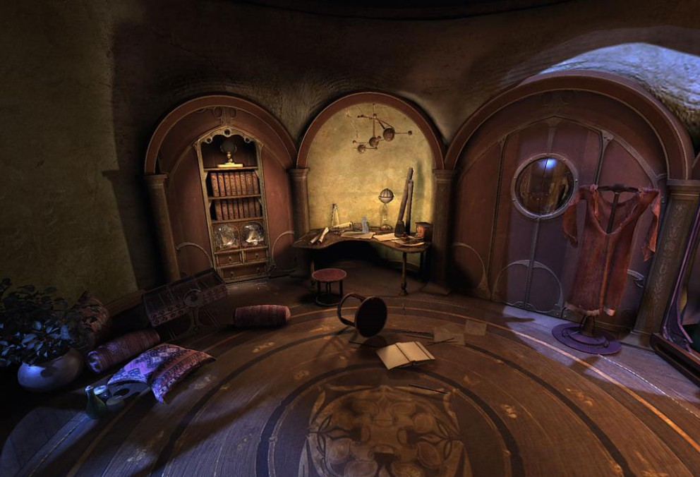
Known vs. unknown
Are the rules of the environment (transition model and rewards associated with states) known to the agent?
Strictly speaking, not a property of the environment, but of the agent’s state of knowledge
vs.

Slide 43
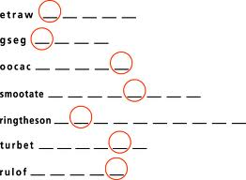
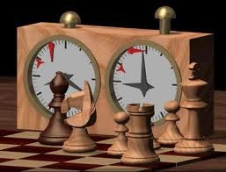
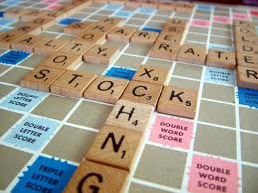
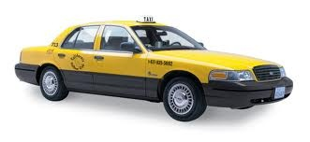
Examples of different environments
Word jumble solver
Chess with a clock
Scrabble
Autonomous driving
Fully
Fully
Partially
Partially
Observable
Deterministic
Episodic
Static
Discrete
Single agent
Deterministic
Strategic
Stochastic
Stochastic
Episodic
Sequential
Sequential
Sequential
Static
Semidynamic
Static
Dynamic
Discrete
Discrete
Discrete
Continuous
Single
Multi
Multi
Multi

Slide 44
Thank You

